Slide 1
Azure SQL Managed Instance 5 years later!
Dec 2023
Presenter name
Company & title
Notes:
Description
Azure SQL Managed Instance marks its fifth anniversary, and it’s not the same old SQL MI it used to be in 2018! This session will highlight the latest and greatest features and enhancements that have been introduced to Azure SQL Managed Instance, showing how they improve the service in terms of performance, usability, scalability, and security. This session is designed for database administrators and cloud architects who are eager to stay at the forefront of cloud database technology and leverage the capabilities of Azure SQL Managed Instance.

Slide 2

How it all began?
Notes:
Intro and basics Once upon a time, in a land far, far away... No one was thinking of migrating their on-prem SQL Server, or any other on-prem database system to a cloud.
…
But things have changed. People started migrating their databases to cloud.
Azure SQL Database has been supporting single database programming model. So, it had no cross-database queries, no cross-database transactions, no linked servers, no SQL Agent, no Transactional Replication, no .NET CLR… Not even the “USE STATEMENT”.
And we’ve figured out we need an awesome Platform as a Service product offering that’s great for lift and shift migrations of SQL Server deployments to Azure.
So, we really needed something that’s PaaS and SQL Server lift and shift migration target. And we code-named it -> Cloud Lifter ☺
So, it had cross-database queries, linked servers, SQL Agent, Transactional Replication, .NET CLR… Event the “USE STATEMENT”!

Slide 3
How it started
How it’s going
Oct 1st, 2018 General Purpose GA
Year 2023
30+ product updates
42
30
25
19
17
8
2018
2019
2020
2021
2022
2023
Notes:
https://azure.microsoft.com/en-us/blog/azure-sql-database-managed-instance-general-purpose-tier-general-availability/
https://azure.microsoft.com/en-us/blog/migrate-your-databases-to-a-fully-managed-service-with-azure-sql-database-managed-instance/

Slide 4
How it started
How it’s going
Oct 1st, 2018 General Purpose GA
Year 2023
30+ product updates
42
30
25
19
17
8
2018
2019
2020
2021
2022
2023
Notes:
https://azure.microsoft.com/en-us/blog/azure-sql-database-managed-instance-general-purpose-tier-general-availability/
https://azure.microsoft.com/en-us/blog/migrate-your-databases-to-a-fully-managed-service-with-azure-sql-database-managed-instance/

Slide 5
How it started
How it’s going
Oct 1st, 2018 General Purpose GA
Year 2023
30+ product updates
aka.ms/sqlminov23
42
30
25
19
17
8
2018
2019
2020
2021
2022
2023
Notes:
On average, more than 20 product updates per year.
https://azure.microsoft.com/en-us/blog/azure-sql-database-managed-instance-general-purpose-tier-general-availability/
https://azure.microsoft.com/en-us/blog/migrate-your-databases-to-a-fully-managed-service-with-azure-sql-database-managed-instance/

Slide 6
How it started
How it’s going
Oct 1st, 2018 General Purpose GA
Year 2023
30+ product updates
aka.ms/sqlminov23
42
30
25
19
17
8
2018
2019
2020
2021
2022
2023
Notes:
On average, more than 20 product updates per year.
https://azure.microsoft.com/en-us/blog/azure-sql-database-managed-instance-general-purpose-tier-general-availability/
https://azure.microsoft.com/en-us/blog/migrate-your-databases-to-a-fully-managed-service-with-azure-sql-database-managed-instance/

Slide 7



Azure SQL
The family of SQL cloud databases
SQL Server on Azure Virtual Machines
Azure SQL Managed Instance
Azure SQL Database
Best for lift and shift or workloads requiring OS-level access
Best for lift and shift, modernizing existing apps at scale
Best for supporting modern cloud apps
Infrastructure-as-a-Service
Platform-as-a-Service
Azure SQL enabled by Azure Arc
Run Azure SQL on premises and in multi-cloud environments

Slide 8
Choosing the right Azure SQL offering
Control
Capabilities
Benefits of:
Microsoft Managed
Managed SQL Server instance as a service
B/R compat with SQL Server, log shipping
DTC and Linked Servers
Service Broker and Event Notifications
SQL Agent and Transactional Replication
.NET CLR integration and ML Services
PaaS
Availability SLA 99.99% or more
Built-in automatic backups
No End of Support hassles
Always up-to-date
24x7 health monitoring and healing
Dynamic and online resource scaling
Yes
Yes
Azure SQL Managed Instance
Managed SQL database as a service
A database scoped programming model
Yes
Azure SQL Database
Customer Managed
Full control and all capabilities of SQL
OS level access
SQL Server versions 2008 - 2022
Patching/Upgrades
3rd party app without certification for SQL PaaS
IaaS
Maintain OS-level control
Lift-and-shift without app refactoring
Faster path to the cloud
2
Yes
Yes
SQL Server on Azure VMs

Slide 9
Choosing the right Azure SQL offering
Control
Capabilities
Benefits of:
Microsoft Managed
Managed SQL Server instance as a service
B/R compat with SQL Server, log shipping
DTC and Linked Servers
Service Broker and Event Notifications
SQL Agent and Transactional Replication
.NET CLR integration and ML Services
PaaS
Availability SLA 99.99% or more
Built-in automatic backups
No End of Support hassles
Always up-to-date
24x7 health monitoring and healing
Dynamic and online resource scaling
Yes
Yes
Azure SQL Managed Instance
Managed SQL database as a service
A database scoped programming model
Yes
Azure SQL Database
Customer Managed
Full control and all capabilities of SQL
OS level access
SQL Server versions 2008 - 2022
Patching/Upgrades
3rd party app without certification for SQL PaaS
IaaS
Maintain OS-level control
Lift-and-shift without app refactoring
Faster path to the cloud
2
Yes
Yes
SQL Server on Azure VMs

Slide 10
Service tiers
General purpose
Business critical
Great for most business workloads.
Great for low latency, extremely fast recovery, and a readable secondary.
Remote storage
Local SSD storage
IOPS
$
Built-in HA
IOPS++
$$$
In-memory OLTP
P
16TB
P
S
S
R
16TB

Slide 11
Service tiers
General purpose
Business critical
Great for most business workloads.
Great for low latency, extremely fast recovery, and a readable secondary.
Compute isolation
Remote storage
Local SSD storage
IOPS
$
Built-in HA
IOPS++
$$$
In-memory OLTP
P
16TB
P
S
S
R
16TB

Slide 12
Service tiers
General purpose
Business critical
Great for most business workloads.
Great for low latency, extremely fast recovery, and a readable secondary.
Compute isolation
Remote storage
Local SSD storage
IOPS
$
Built-in HA
IOPS++
$$$
In-memory OLTP
Network isolation

Slide 13
Hardware configuration
5.1 GB
+35%
Standard series (Gen5) HW
Premium-series HW
4 – 80 vCores
5.1 GB memory / vCore 408 GB max memory
16 TB max GP storage 4 TB max BC storage
Intel Broadwell, Skylake and Cascade Lake, 2.3-2.5 GHz
4 – 128 vCores
7 GB memory / vCore 560 GB max memory
16 TB max GP storage 5.5 TB max BC storage
Intel 8370C (Ice Lake), 2.8 GHz

Slide 14
Hardware configuration
5.1 GB
+35%
+166%
Standard series (Gen5) HW
Premium-series HW
Memory optimized premium-series HW
4 – 80 vCores
5.1 GB memory / vCore 408 GB max memory
16 TB max GP storage 4 TB max BC storage
Intel Broadwell, Skylake and Cascade Lake, 2.3-2.5 GHz
4 – 128 vCores
7 GB memory / vCore 560 GB max memory
16 TB max GP storage 5.5 TB max BC storage
Intel 8370C (Ice Lake), 2.8 GHz
4 – 128 vCores
13.6 GB memory / vCore 870 GB max memory
16 TB max GP storage 16 TB max BC storage
Intel 8370C (Ice Lake), 2.8 GHz
aka.ms/sqlmi-hw

Slide 15
Hardware configuration
5.1 GB
+35%
+166%
Standard series (Gen5) HW
Premium-series HW
Memory optimized premium-series HW
4 – 80 vCores
5.1 GB memory / vCore 408 GB max memory
16 TB max GP storage 4 TB max BC storage
Intel Broadwell, Skylake and Cascade Lake, 2.3-2.5 GHz
4 – 128 vCores
7 GB memory / vCore 560 GB max memory
16 TB max GP storage 5.5 TB max BC storage
Intel 8370C (Ice Lake), 2.8 GHz
4 – 128 vCores
13.6 GB memory / vCore 870 GB max memory
16 TB max GP storage 16 TB max BC storage
Intel 8370C (Ice Lake), 2.8 GHz
aka.ms/sqlmi-hw

Slide 16
Online scaling operations
Configuring instance size (vCores and storage), service tier, and hardware configuration is an online operation.
This means that even though the operation may take some time, the instance is available all the time, except for several seconds towards the end of the operation, when a failover (a brief restart) happens.

Slide 17
Online scaling operations
Configuring instance size (vCores and storage), service tier, and hardware configuration is an online operation.
This means that even though the operation may take some time, the instance is available all the time, except for several seconds towards the end of the operation, when a failover (a brief restart) happens.

Slide 18
Connectivity and security
VNet local endpoint
Public endpoint
Private endpoint
Very secure.
More demanding e2e configuration.
Less secure.
Very flexible.
Enables connections from any internet location.
Very secure.
Enables most features.
Easy configuration.
Azure concept.
aka.ms/sqlmi-pes

Slide 19
Connectivity and security
VNet local endpoint
Public endpoint
Private endpoint
Very secure.
More demanding e2e configuration.
Less secure.
Very flexible.
Enables connections from any internet location.
Very secure.
Enables most features.
Easy configuration.
Azure concept.
aka.ms/sqlmi-pes

Slide 20
Connections with retry logic are recommended
Because of automated maintenance events, online scaling operations and unplanned events – to ensure smooth experience on Azure SQL you should have a retry logic on all connections.

Slide 21
DEMO | BC and GP failover

Slide 22
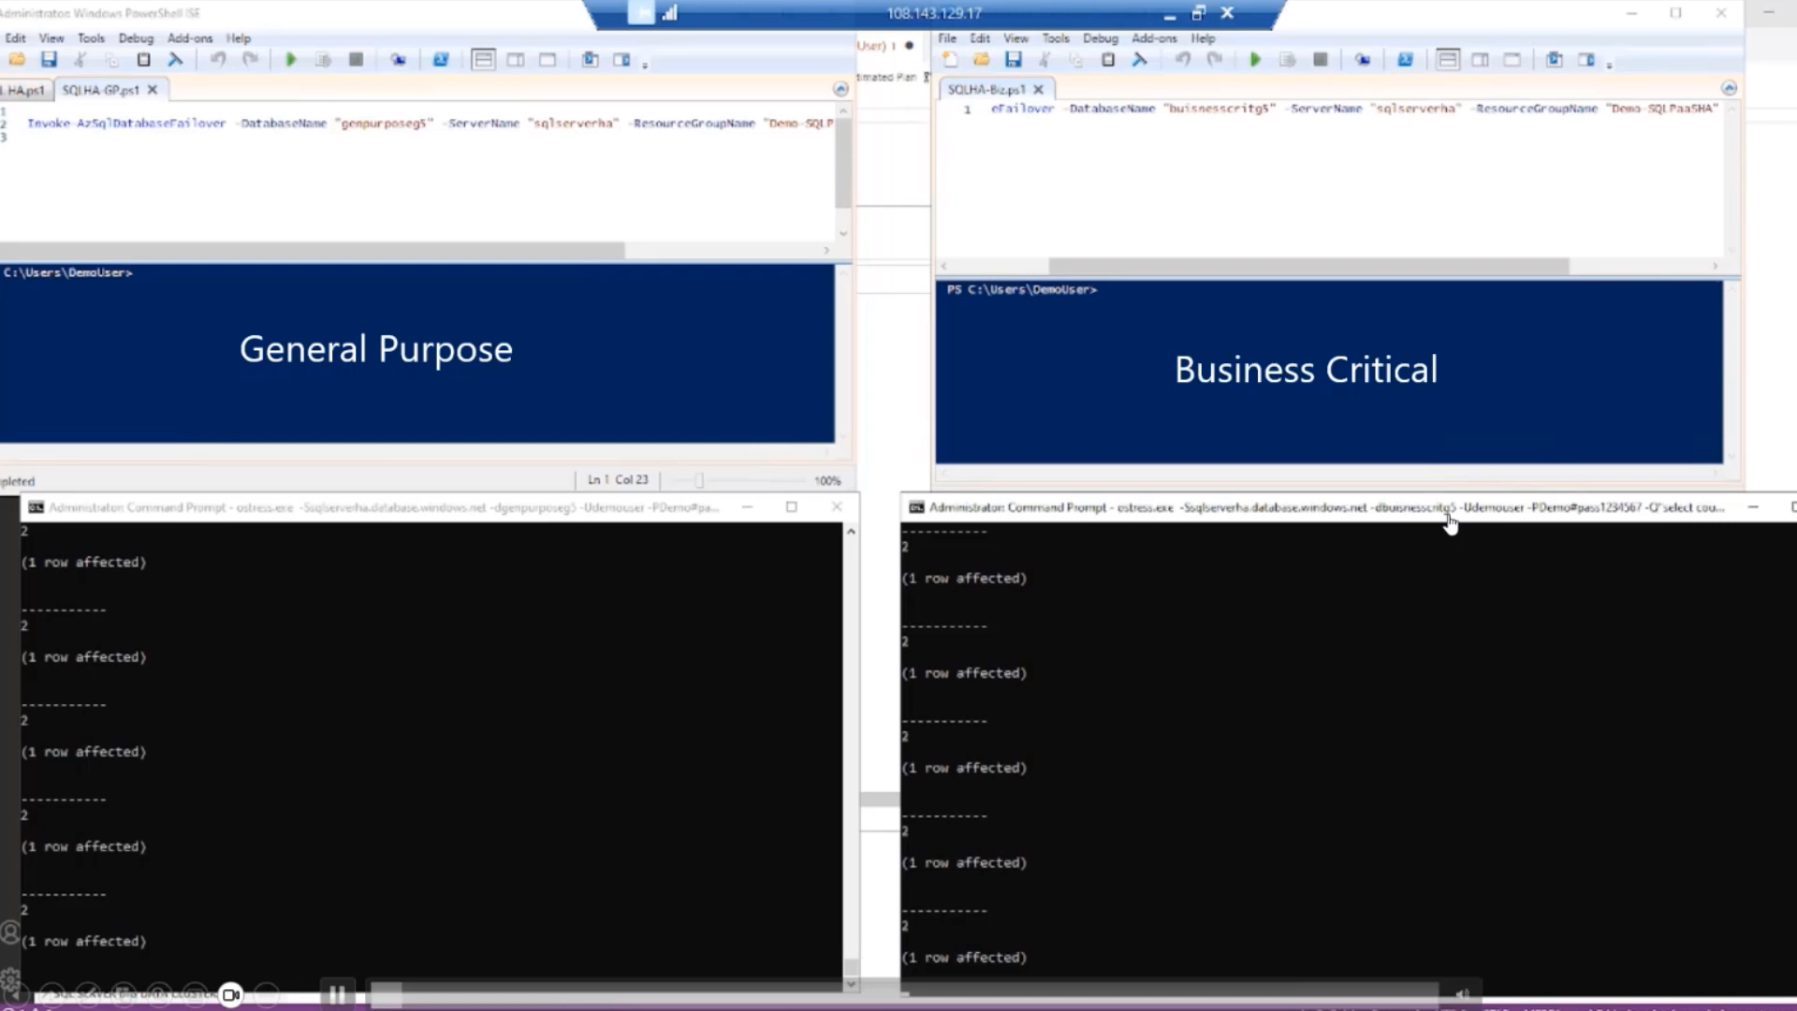
Failover demo

Slide 23
Price & cost optimization

Slide 24
Total cost of ownership
BCDR/HA
Automatic upgrades
Azure SQL MI (PaaS) is for you if you’d like to delegate business continuity, disaster recovery, HA to Microsoft Azure.
Azure SQL MI (PaaS) is for you if you’d like to delegate dealing with critical OS and SQL security patches, and SQL CUs, major version upgrades and certifications.
Notes:
https://azure.microsoft.com/en-us/blog/microsoft-azure-innovation-powers-leading-priceperformance-for-sql-server/

Slide 25
Start/Stop for GP
UX
What happens
on SQL MI stop?
Pay attention
User initiated via Azure Portal, REST API, Azure PowerShell or CLI
Scheduled start/stop.
Transactions terminated.
Billing stopped immediately for vCores and SQL license.
Stop cannot be called if SQL MI resize operation, database CRUD, or database restore is in progress.
aka.ms/sqlmi-startstop

Slide 26
Start/Stop to GP
If SQL MI is stopped outside of work hours, for example, Mon to Fri from 5PM to 9AM, and during Sat and Sun, the savings can be up to 70%.

Slide 27
Reserved Instance (RI) pricing
A RI is an upfront commitment for purchasing reserved capacity, that comes with a discount.
Discount varies by the commitment duration, and it’s 20% for 1 year and 30% for 3 years, and more with AHUB.
Standard series HW (Gen5)
Premium series HW
Memory optimized Premium series HW
aka.ms/sqlmi-price

Slide 28
Reserved Instance (RI) pricing
A RI is an upfront commitment for purchasing reserved capacity, that comes with a discount.
Discount varies by the commitment duration, and it’s 20% for 1 year and 30% for 3 years, and more with AHUB.
Standard series HW (Gen5)
Premium series HW
Memory optimized Premium series HW
aka.ms/sqlmi-price

Slide 29


License benefits
Dev/Test
Azure Hybrid Benefit (AHUB)
Failover Rights Benefit
(SQL MI GeoDR)
Hybrid Failover Rights
Benefit
Free SQL license for Dev/Test Subscription
Bring your own license (EA agreement with SA)
Free SQL license for passive geo-replica (auto-failover group)
Free SQL license for passive replica hosted on SQL MI.
AHUB
DR
DR
DEV/TEST
EA with SA
RW
RW

Slide 30







Free offer – coming soon
64 GB data storage
General Purpose
4 vCores
8 vCores
720 vCore hours per month
12 Months Duration
1 instance per subscription
Start/stop enabled

Slide 31
Migrations (out there & back)

Slide 32
Storage engine compatibility
Trivia time
Here are 3 SQL Server basic storage engine questions:
- Which Azure PaaS service allows you to restore a SQL Server backup?
- Which Azure PaaS service allows you to take a full backup out of the service?
- Which Azure PaaS service gives you a SQL Server-compatible backup that you can use?
Azure SQL Managed Instance provides you with SQL Server 2022 fully compatible backups! You can restore them on SQL Server on Azure VMs, on SQL Server on premises, anywhere!
This is guaranteed through SQL Server storage engine compatibility.

Slide 33
Out there and back
Log Replay Service
MI Link
Private endpoint
Slow and steady.
Allows controlled point in time recovery.
Offline.
SQL Server 2008+
Back journey is possible but will be slow and on your own.
Precise and fast.
Allows controlled point in time recovery.
Online.
SQL Server 2016+*
Allows swift back journey*.
Very secure.
Enables most features.
Easy configuration.
Azure concept.

Slide 34
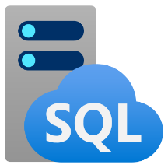
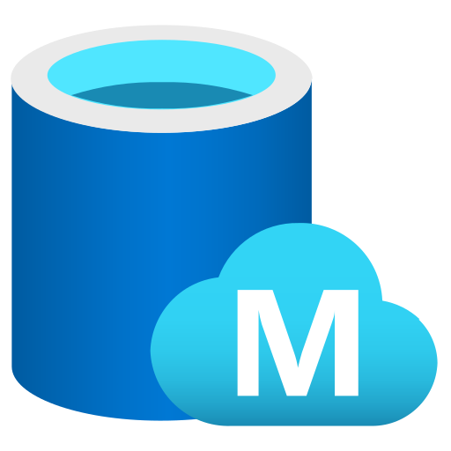

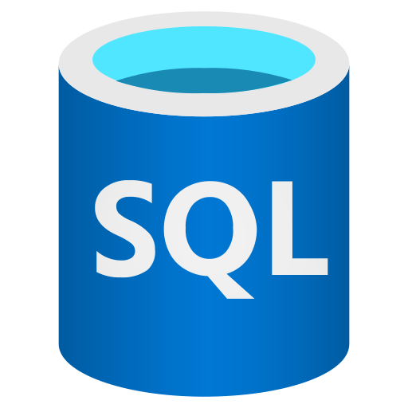

Log Replay Service
3. Cutover to the cloud when ready
Custom migrations to the cloud using LRS for SQL Server 2008-2022
Based on the log shipping technology
Database scoped
Full control of the migration process
Cutover when ready
3
2
Managed Instance
Migrated DB
2. Start LRS service in the cloud (continuous sync)
1
Azure Blob Storage
2.1 Monitor the operation progress
2.2. Stop the operation if needed
1. Copy database backups to Azure Blob Storage
SQL Server database
Backup files
Execution steps:
Enable backup log shipping from SQL Server to Azure Blob Storage, schedule as Agent job
Start the Log Shipping Service (LRS) in the cloud
Cut-over manually, or automatically to SQL MI when ready
There are 2 options to run LRS
Autocomplete
Continuous mode

Slide 35
When to use LRS
You need more control for your database migration project.
There's little tolerance for downtime during migration cutover.
The Database Migration Service executable file can't be installed to your environment.
The Database Migration Service executable file doesn't have file access to your database backups.
No access to the host OS is available, or there are no administrator privileges.
You can't open network ports from your environment to Azure.
Network throttling, or proxy blocking issues exist in your environment.
Backups are stored directly to Azure Blob Storage through the TO URL option.
You need to use differential backups.

Slide 36
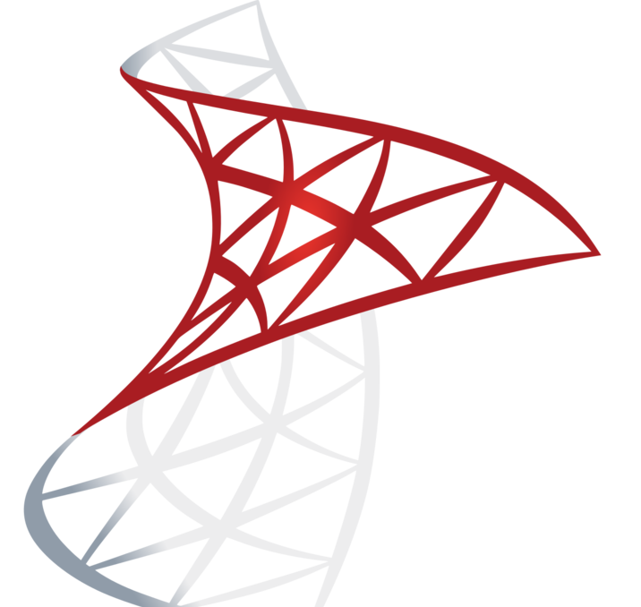
Link feature for SQL MI
Distributed Availability Groups
Leveraging the proven Availability Group technology stack.
Connection between SQL Server and SQL MI is bridged using distributed AG.
Distributed AG spans two separate Availability Groups, across domains and across platforms.
WSFC is not required SQL Server 2017, 2019 and 2022.
Single-node WSFC is required for SQL Server 2016.
You can use mixed versions of SQL Servers to connect to SQL MI.
SQL Server
Azure SQL MI
Distributed AG
Availability Group 1 (SQL Server)
Availability Group 2 (SQL MI BC)

Slide 37

Link feature for SQL MI
DR = failover + failback
Offline failback
Online failback (Preview)
MI Link
MI Link
failover
failover
MI Link
RESTORE DATABASE
FROM URL = …
BACKUP DATABASE db1
TO URL = …
WITH COPY_ONLY
failover
Azure Storage

Slide 38
MI Link: supported SQL Servers versions & editions:
SQL Server Versions | Editions | Servicing update requirement
SQL Server 2022 (16.x) | Supported: Enterprise, Developer, Standard | RTM
SQL Server 2019 (15.x) | Supported: Enterprise, Developer, Standard | CU17
SQL Server 2017 | Planned
SQL Server 2016 (13.x) | Supported: Enterprise, Developer, Standard | SP3 and Azure Connect Feature Pack
Tooling available:
Automated setup with wizards in SSMS 18.12.1
Scripts with Az.SQL 3.9.0
Fully automated migration scripts using SQL PowerShell:
https://github.com/microsoft/Azure-Managed-Instance-Link/tree/main/cmdlets

Slide 39
MI Link: advanced scenarios
Disaster recovery in Azure (SQL MI)
Continuous replication to/from on-premises, or other cloud
Performing failover to MI, but also failing back if/when needed.
Migrations with return ticket
Migrate faster, knowing that you can go back with minimal downtime, days or weeks after migration.
Perform live rehearsals on MI during off-peak hours (e.g. weekend), and then go back to finish preparations for the “grand opening”.
Hybrid and multi-cloud mobility
On-demand online replication
Regulatory requirements introducing obligation of testing cloud exit plans to validate cloud exit strategy
Avoiding vendor lock-in
Leveraging cloud elasticity during peak season – bursting in Azure
Seasonal online migration to/from Azure to protect CAPEX investments. Spend on OPEX only when necessary, during the peak season.
Customer example: moving game titles to and from SQL MI based on the current load and cost analysis

Slide 40
LRS vs MI Link: feature comparison
LRS | MI Link
Based on log shipping | Based on AG stack
SQL Server 2008 and up | SQL Server 2016 and up
Replication every few minutes | Near real-time replication
Does not have accessible R/O secondary | R/O secondary available (to test, offload workloads, etc.)
Uses public endpoint | Private networks only, needs ports configured
LRS job can run up to 30 days | Unlimited in duration
No true online migration to BC | True online migration to BC (and GP)
In some cases, cutovers can take a while | Best possible downtime migration

Slide 41
Migration tooling

Slide 42
Database movement vehicles for Managed Instance
Offline
Using Backup and Restore
Database cross-Instance PITR (point in time restore in the same subscription)
Cross-subscription PITR (point in time restore across subscriptions)
Database Geo-Restore (last backup restore across regions)
Online
Online database copy and move (using Availability Groups technology)
Transactional Replication

Slide 43

Migrating from SQL Server to Managed Instance

Slide 44
Migration vehicles to Managed Instance
Offline
Backup and restore
Online
SQL migration extension for Azure Data Studio (ADS) (DMS v2) – fully automated
Log Replay Service (LRS) – orchestrate yourself
Managed Instance Link – hybrid link

Slide 45
SQL migration extension for Azure Data Studio (ADS)
Fully automated migration option

Slide 46
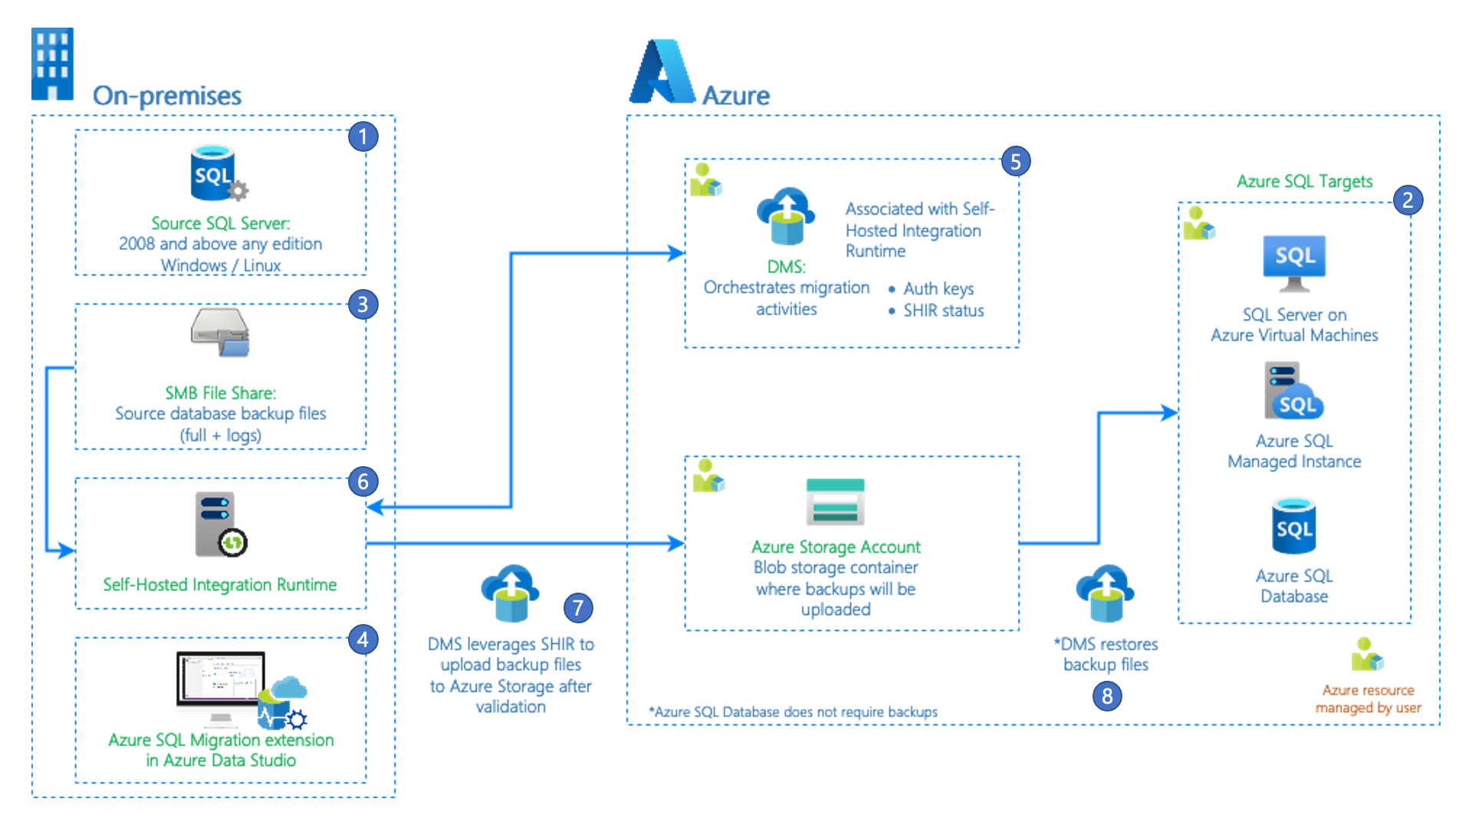
SQL migration extension for Azure Data Studio (ADS)
Database assessment
Integrated with DMS
Recommends migration destination
Orchestrates the migration

Slide 47
When to use LRS
Consider using LRS in the following cases:
You need more control for your database migration project.
There's little tolerance for downtime during migration cutover.
The Database Migration Service executable file can't be installed to your environment.
The Database Migration Service executable file doesn't have file access to your database backups.
No access to the host OS is available, or there are no administrator privileges.
You can't open network ports from your environment to Azure.
Network throttling, or proxy blocking issues exist in your environment.
Backups are stored directly to Azure Blob Storage through the TO URL option.
You need to use differential backups.

Slide 48
When does it make sense to use ADS ext. & LRS vs. Link
MI Link
Minimum downtime migrations
True online migration to BC
SQL Server 2016 and up
When customers need access to R/O secondary – analytics especially, ETL workloads
When customers are not ready to migrate for a long time, or need a very long time
VM -> MI migrations (network config simple)
ADS extension, or LRS
When minimum downtime is not an issue
SQL Server 2005-2014
When network configuration is an issue (can only use public endpoints)
Non-sensitive workloads
When customers can do their migrations quickly

Slide 49
When does it make sense to use ADS ext. & LRS vs. Link
MI Link
Minimum downtime migrations
True online migration to BC
SQL Server 2016 and up
When customers need access to R/O secondary – analytics especially, ETL workloads
When customers are not ready to migrate for a long time, or need a very long time
VM -> MI migrations (network config simple)
ADS extension, or LRS
When minimum downtime is not an issue
SQL Server 2005-2014
When network configuration is an issue (can only use public endpoints)
Non-sensitive workloads
When customers can do their migrations quickly

Slide 50
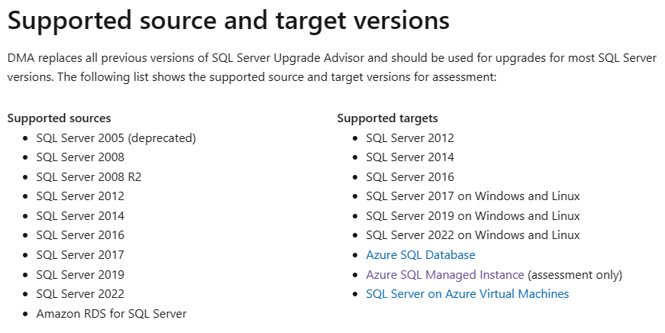
DMA – Database Migration Assistant
Not just a GUI tool,
but it has a CLI version as well !
https://learn.microsoft.com/en-us/sql/dma/

Slide 51
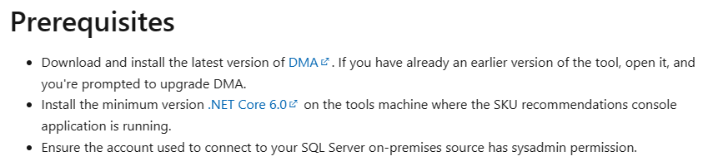
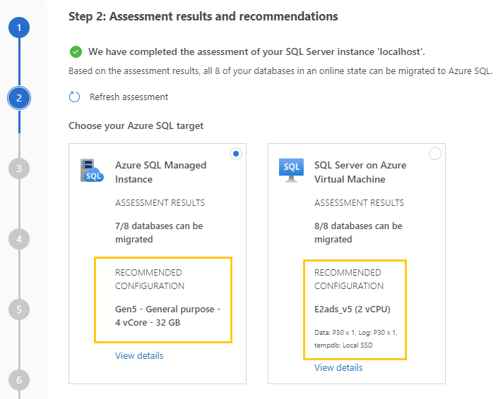
SKU Recommendation
https://learn.microsoft.com/en-us/sql/dma/dma-sku-recommend-sql-db
The tool will collect your performance data, and will recommend a corresponding
Service tier, Hardware and sizing configuration for Azure SQL Managed Instance

Slide 52
Azure SQL Managed Instance Latest updates

Slide 53

Latest Updates
Quiz: How many updates will I mention today?

Slide 54
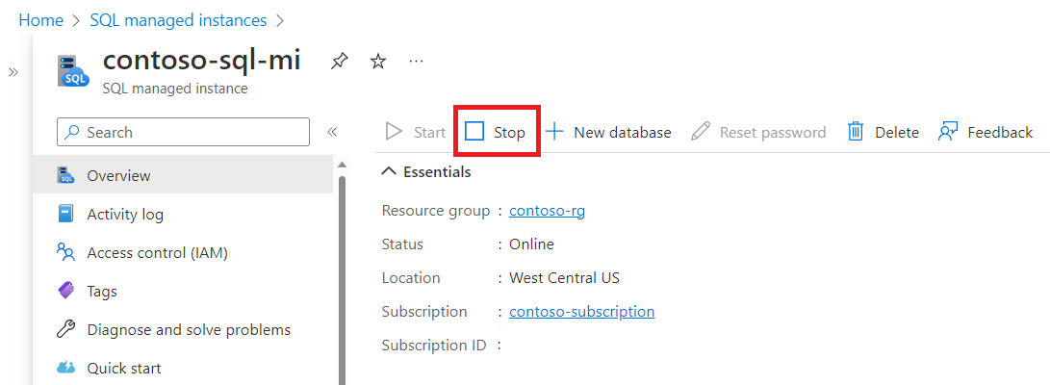
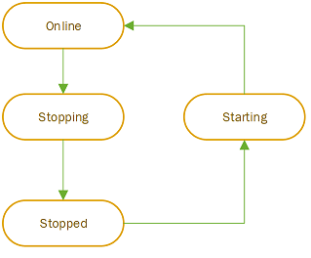
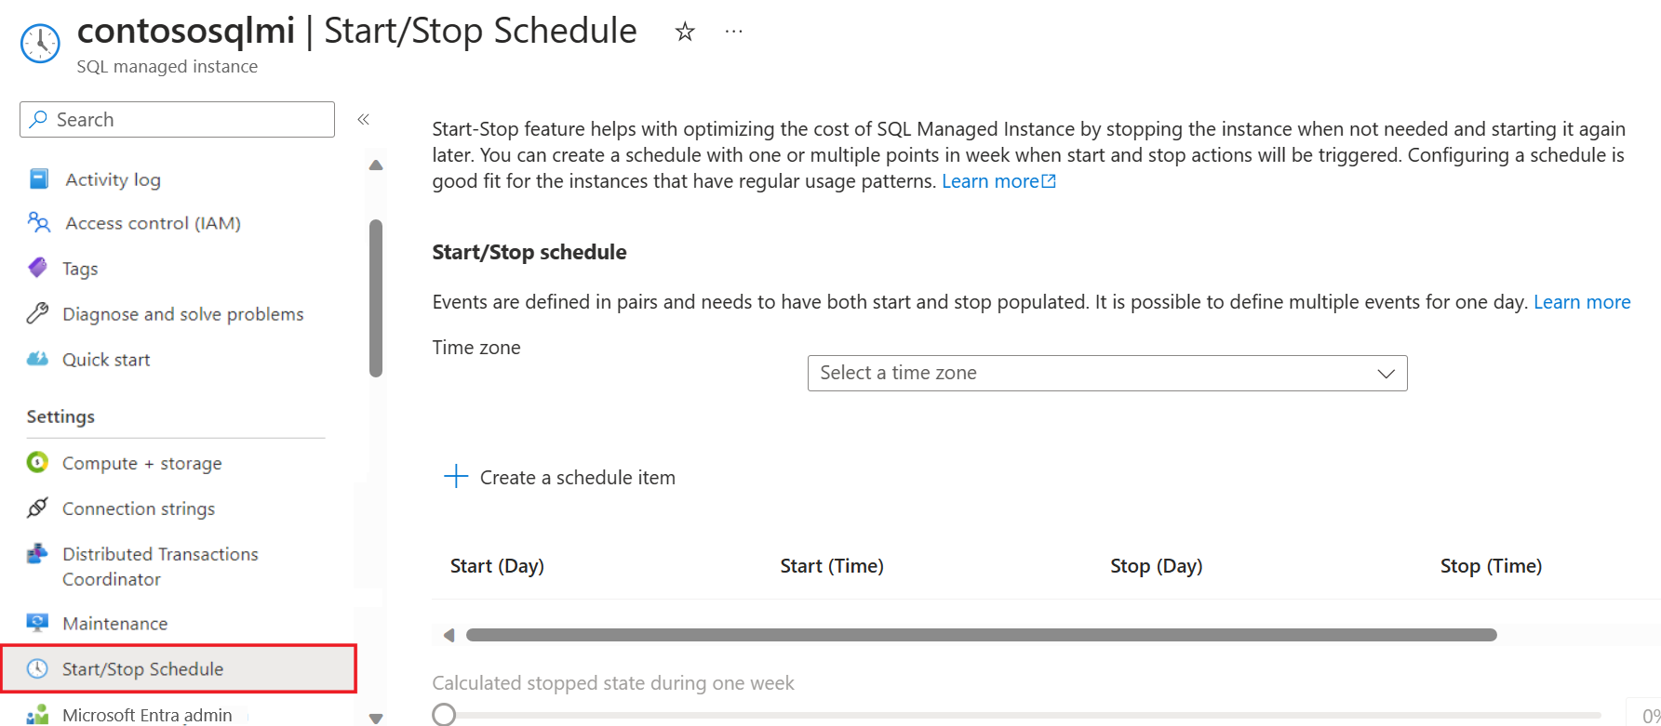
Start / Stop in General Availability

Slide 55
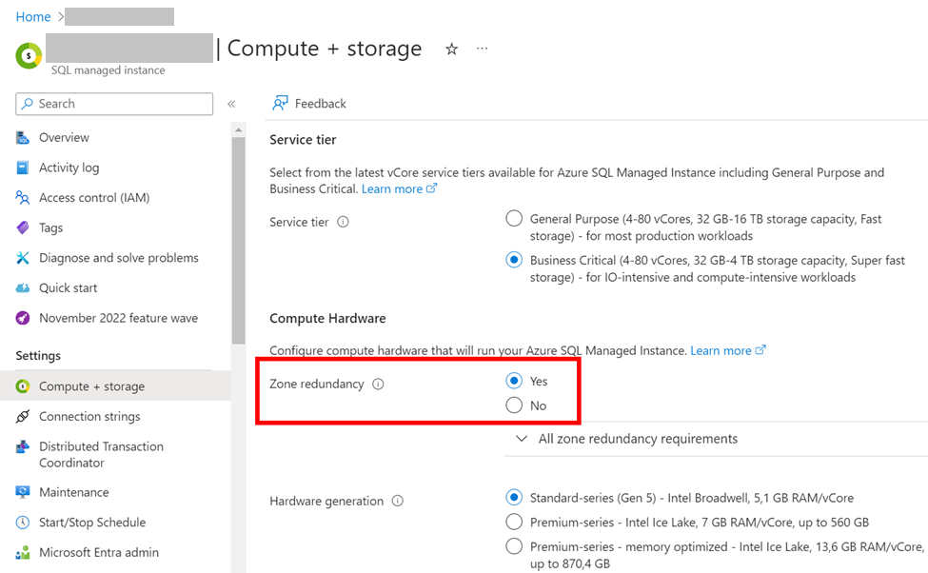
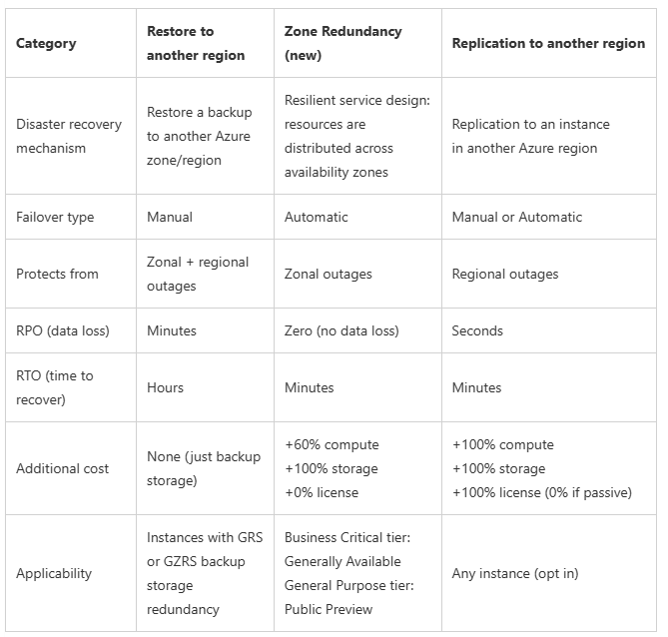
Zone Redundancy for BC in GA and for GP in Preview

Slide 56
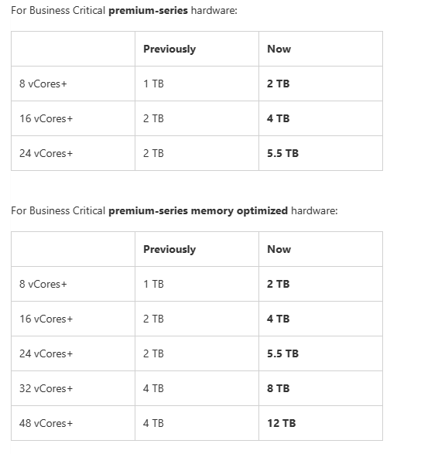
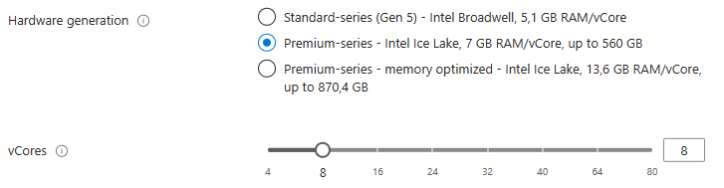
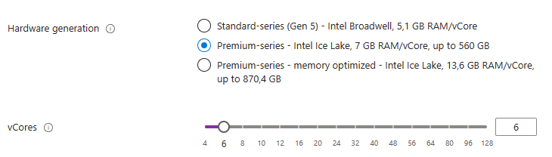
Improved price/performance & flexibility in the Business Critical service tier on Azure SQL MI
More storage at lower CPU vCores
More choices for the number of CPU vCores for the premium-series and premium-series memory optimized hardware
More storage for the premium-series by supporting up to 16 TB
More hardware diversity through the support for premium-series memory optimized hardware in all regions

Slide 57
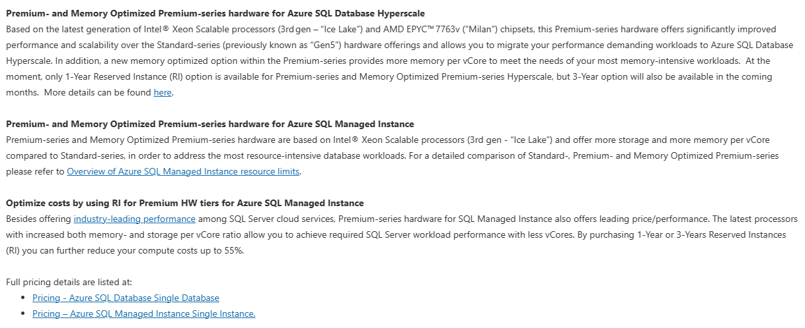
Premium-series Reserved Capacity for Azure SQL Managed Instance

Slide 58
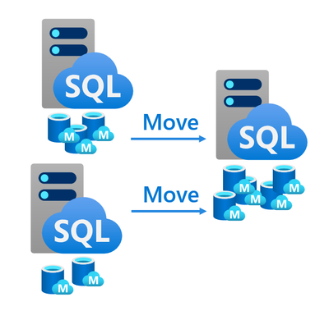
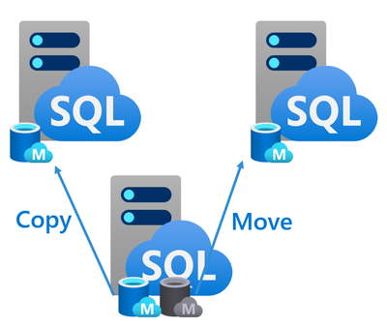
GA of database copy and move for Azure SQL Managed Instance

Slide 59

GA for November 202… Feature Wave
Faster provisioning for select configurations is now around 30 minutes
Relaxed networking requirements (simplification of the networking)
Enhanced virtual cluster
DTC for SQL MI
Zone Redundancy
Starting/Stopping of the instances

Slide 60
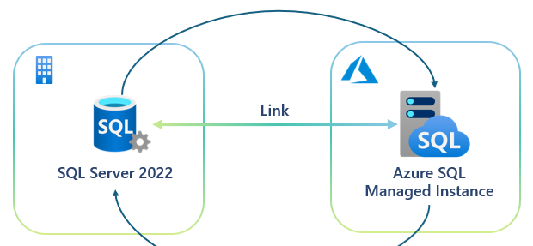
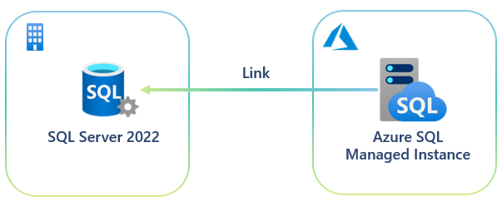
Online disaster recovery between SQL Server 2022 and Azure SQL Managed Instance
Creating the link from Azure SQL MI
BI-directional failover

Slide 61
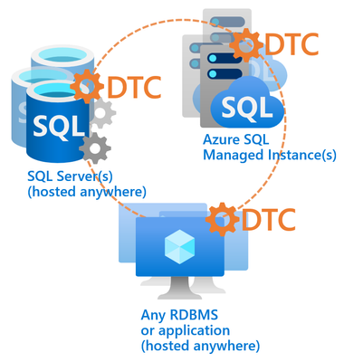
GA of DTC for Azure SQL Managed Instance
Great news!
You won’t have to worry about DTC log file management, as we’ve made it out-of-the-box both managed and highly available, same as Azure SQL Managed Instance.

Slide 62
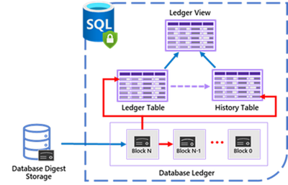
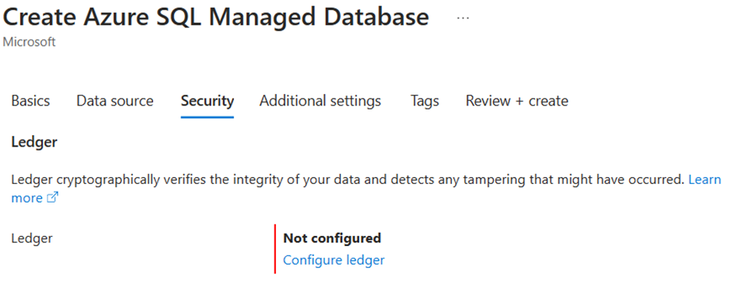
Ledger in Azure SQL Managed Instance

Slide 63
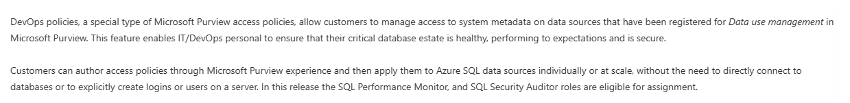
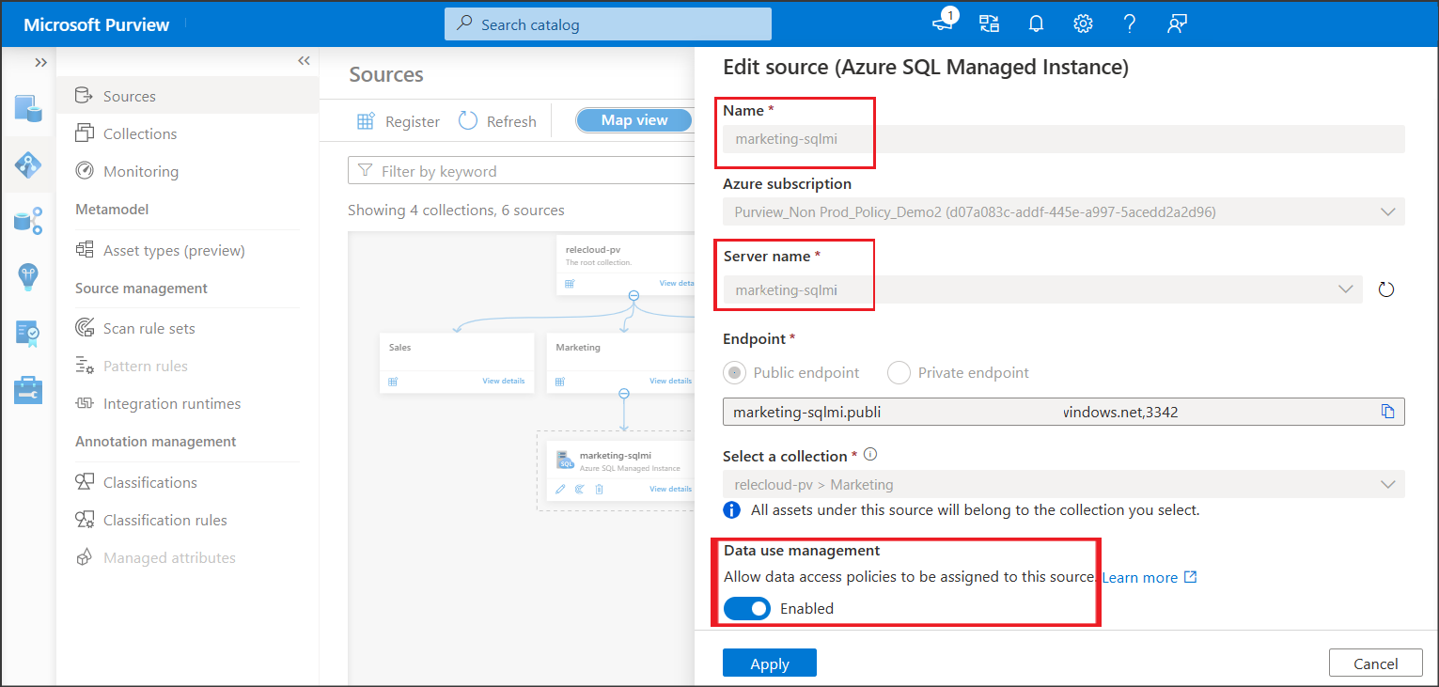
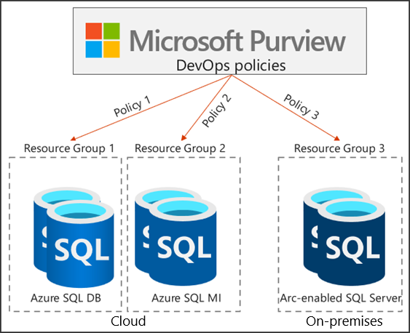
GA announcement - Microsoft Purview DevOps policies for Azure SQL Managed Instance

Slide 64


But wait, there is more

Slide 65
Contact SQL MI product group
aka.ms/contactsqlmi

Slide 66
YouTube
Newsletter
Blog
MI in Y ‘23
aka.ms/sqlmi-youtube
aka.ms/sqlmi-letter
aka.ms/sqlmi-blog
aka.ms/sqlminov23

Slide 67
Thank you!
Name | Title & Company linkedin.com/in/…

